Slide 1
PCA

Slide 2
Distillation of Information: Why
What we have: the features (unsupervised setting)
We might have a lot of columns with very less, but statistically significant information
We want to decrease the bulk of model training by ignoring insignificant values

Slide 3
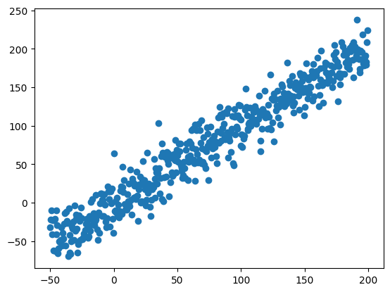
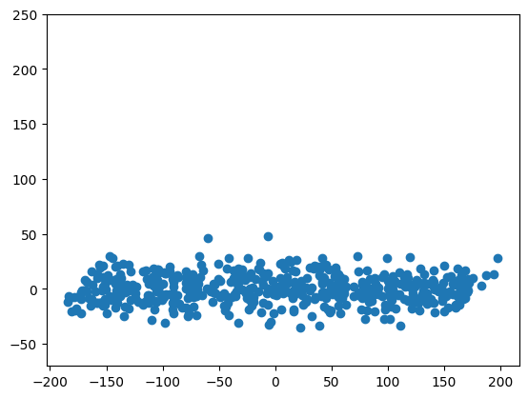
Distillation of Information: How
If a lot of columns are linearly correlated, if we can ‘accumulate’ information on one of the axes, we can maybe drop the other.

Slide 4
Distillation of Information: PCA
Eigen Vectors can determine the axes with most information: Eigen Value Decomposition
Use Eigen Value Decomposition to transform the original matrix, then drop rows corresponding to lower eigen values (indicating low information)
Reducing dimensions, while sacrificing very little information

Slide 5
Taking it to higher dimensions: Kernel PCA
PCA only captures linear correlations
If the data is transformed to higher dimensions, higher order relations can be captured
Kernel PCA: Transform the data to a higher dimension (using a ‘Kernel’) and then to the PCA

Slide 6
Decision Trees

Slide 7
Decision Trees
Decision Trees are trees (not necessarily binary) whose edges denote a decision
At each step, we need to increase the homogeneity of the resultant dataset
Very simple and popular, forms a basis of many powerful non-neural models eg. Random Forests, XG Boost, etc

Slide 8
Decision Trees: Advantages
Highly interpretable, easy to understand and explain
Very simple structure, has had little change over the years
Less preprocessing is required as each column can be dealt on their own
Can handle categorical and continuous variables

Slide 9
Decision Trees: Disadvantages
Very prone to overfitting, if not limited by depth, it can also completely ‘mug up’ the train data - this is a huge problem as it requires a lot hyperparameter tuning
This will come in hand with methods like Random Forests

Slide 10
Decision Trees: Basic Idea
Figure out what ‘question’ (read decision) is the best. Better the question, better the model
Higher the question in the tree, the more influence it has on the final output
Ask simple questions
Related to a single variable
Simple comparisons

Slide 11
What question is the ‘Best’?
We need to increase the homogeneity of the resultant at each step. Why?
How to judge the homogeneity?
Gini Index
Entropy
Each question is judged based on the information gain. Higher the information gain, the better is the question.

Slide 12
Decision Tree’s Simple Algo
We have the current dataset
Calculate information gain corresponding to different columns and rows
Take a decision based on the highest information gain and split the dataset into parts based on that (for example if Age > 40)
These splits will be more homogenous than the original dataset
Repeat till complete homogeneity is achieved. Leaf nodes are completely homogenous (unless a max depth limit is asserted)

